Slide 1
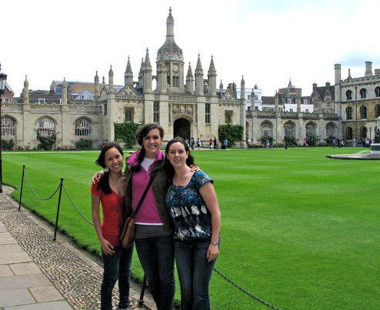
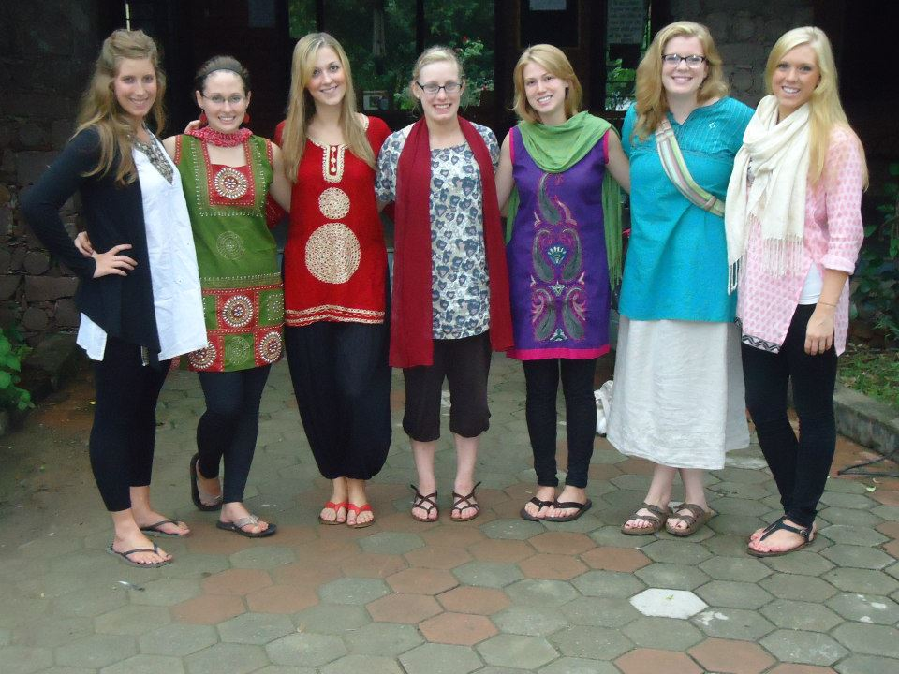
Studying Abroad: A How-to guide for Science Students!
All of your questions answered!

Slide 2
Why study abroad?
Function independently, gain self-esteem
Future employability
Once in a lifetime opportunity
Meet contacts interested in your fields from around the world
Learn about a new culture
Notes:
Live the life, university life in other places, customs and traditions, ethics, regulations, lifestyles, stress levels, etc.

Slide 3
“Bad” reasons to study abroad
Free Vacation, DUDE!!!
Wrong.
No rules! No accountability!
Strike two.
Easier classes.
Not the case.
My parents want me to.
This is your choice!
Notes:
You should not study 24/7, but if you are looking for a vacation, you should just take a vacation

Slide 4
Studying Abroad… is it for me?
Can I be away from UW, family, and friends?
Will I enjoy it?
Worth the adjustments and culture shock?
Can I afford it?
Can I fit it into my schedule?

Slide 5
Studying Abroad… is it for me?
Can I be away from UW, family, and friends?
Will I enjoy it?
Worth the adjustments and culture shock?
Can I afford it?
Can I fit it into my schedule?

Slide 6
Can I afford to study abroad?
The International Academic Programs office (IAP)
Studyabroad.wisc.edu
Financial advisors
Some programs cheaper than UW tuition costs!
Funding streams
scholarships (both merit- and need-based)
Loans through financial institutions
Support from family members
Volunteer organizations

Slide 7
Can I fit a study abroad program into my schedule?
Yes!!!
But my advisor has me on a 4- year plan…
Fulfill breadth requirements
Summer or Winter break programs
Other course options Final semester of Biocore senior year Biochem 501 instead of 507/508
Notes:
Also, taking summer classes to finish requirements, taking sequences early (physics or ochem)

Slide 8
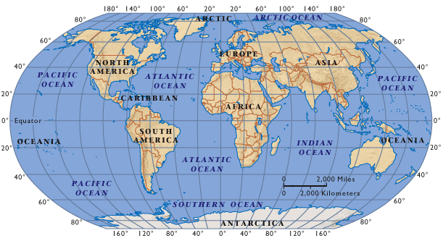
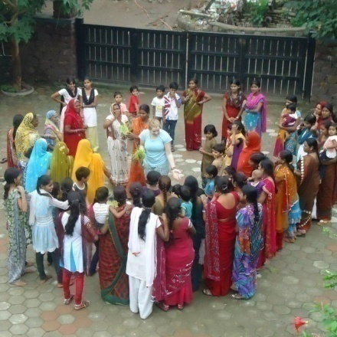
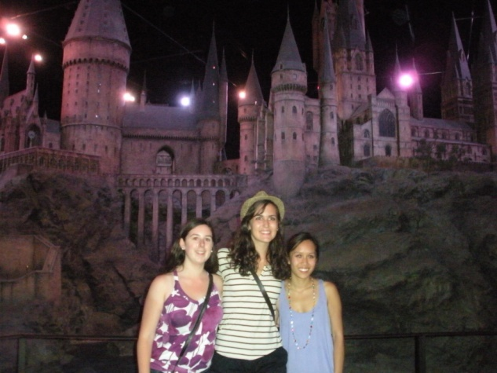
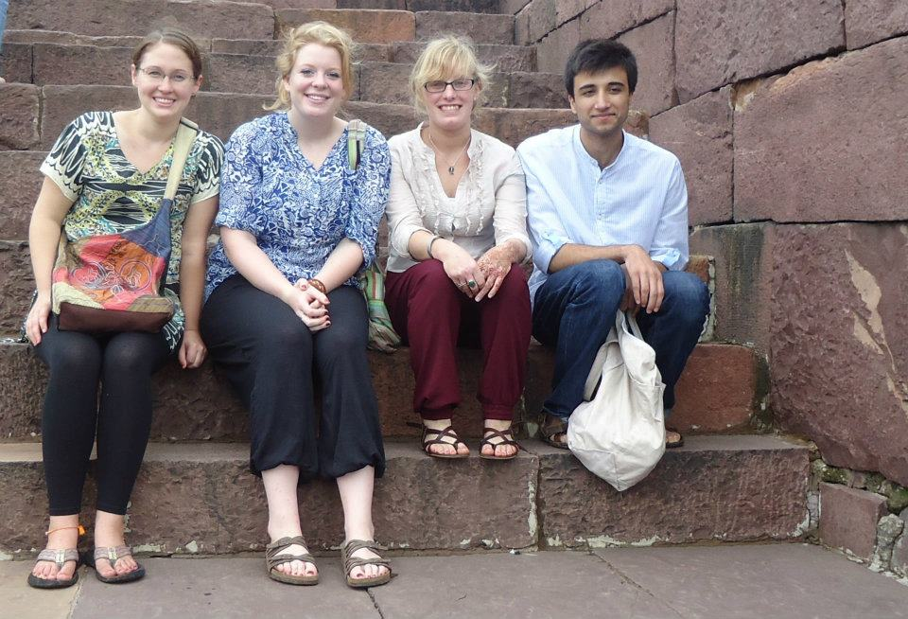
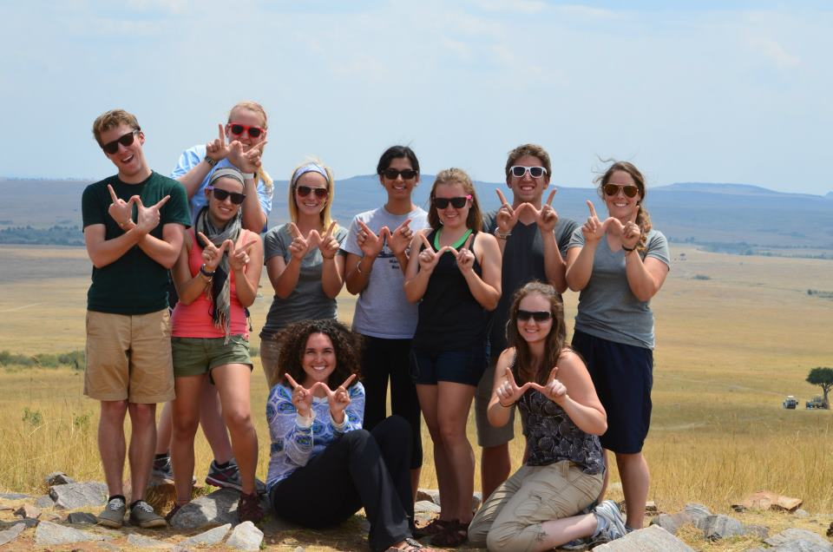
We’ve done it and so can you!

Slide 9
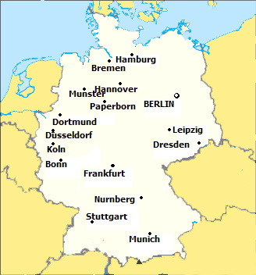
Jess Kazmierczak
Biochemistry and German Major
Studied abroad 2nd semester sophomore year
Bonn, Germany
Language program
Class-oriented with optional science internship

Slide 10
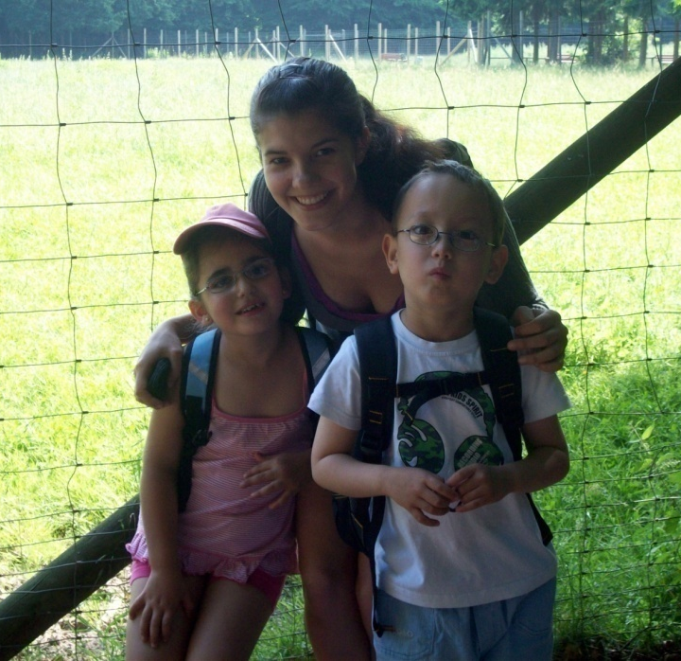
Jess Kazmierczak
Transferred back 18 credits
Earned 2nd major in German
Volunteered helping kids with disabilities in the classroom
Currently in Berlin, Germany earning a Master’s of Science in International Public Health
Contact: jessica.kazmierczak@gmail.com

Slide 11
Jamye Moon
Senior in Biology
global health and environmental studies certificates
2 cr. summer field experience program in Kenya
COGRI/Global Health Institute program

Slide 12
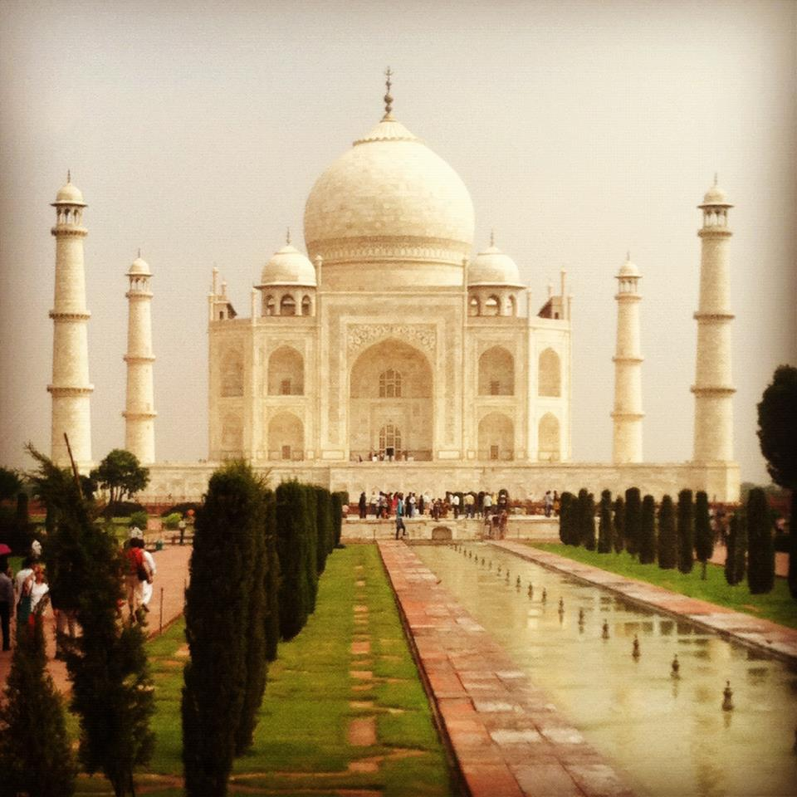
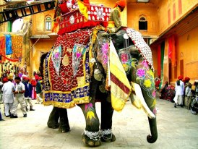
Gail Lavoie
Junior in Neurobiology
Summer volunteering in India
Field experience for Global Health certificate

Slide 13
International Internships

Slide 14
Summer Cambridge and Oxford Research Experience(SCORE)
University of Cambridge or Oxford University, UK
Deadline: December 3rd
Program: July 1- August 30
http://www.biochem.wisc.edu/score/ default.aspx

Slide 15
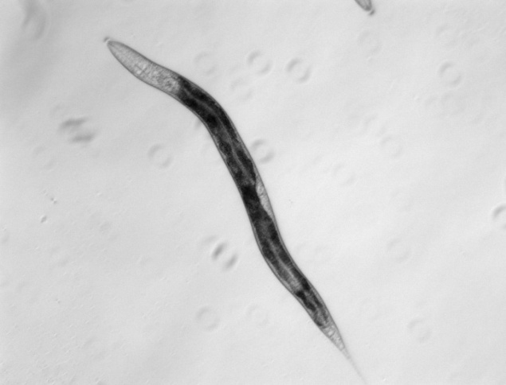
Kayla McKaveney
Junior in Biochemistry
Summer research internship: SCORE program
University of Cambridge, UK
Worked with the genetics of developmental regulation by micro RNAs in C. elegans

Slide 16
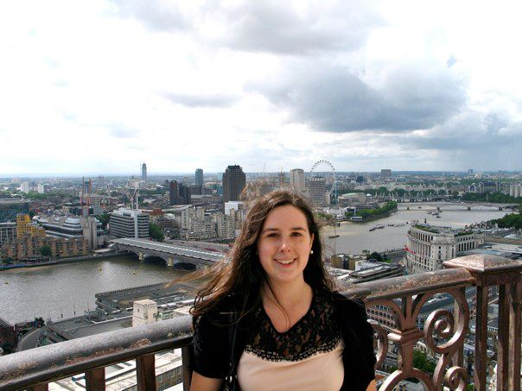
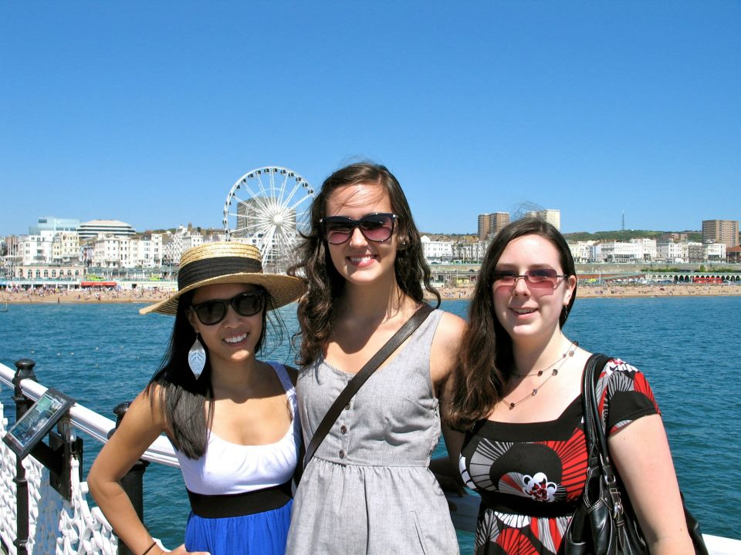
Kayla Mckaveney
Developed laboratory skills
Learned about differences in US and European research environments
Traveled to London, Paris, Oxford, and Barcelona with fellow UW students
May pursue grad school abroad!
Contact: mckaveneyk@gmail.com

Slide 17
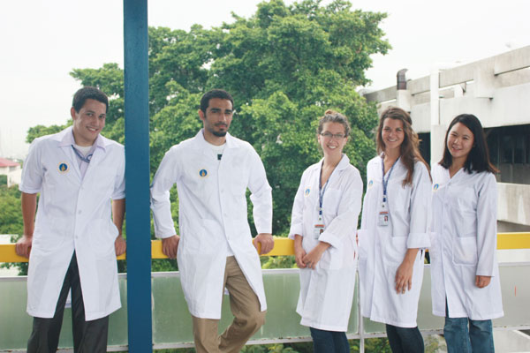
IRES – Microbiology in Thailand
Stipend of $4000 or more, airfare, food, and housing included!
10 weeks (late May – Early August)
Wonderful cultural experience
Eligibility: biological science major, preferably Junior (up to 7 accepted)
Application: Nov 15- Dec 7
Info Sessions in MSB lobby in Microbe Place
Oct 25, 5-7 pm
Oct 26, 1-3 pm
http://bact.wisc.edu/programs_ires.php
Contact Jon Roll (jtroll@wisc.edu) or Rachel Wong (rwong2@wisce.du)

Slide 18
Khorana Program
Mission: “build deep-rooted bridges to strengthen the strategic partnership between US and India”
Exchanges students from US and India
10 weeks (June – August)
Matched up with partner institutions in India
Deadline: February, 2013
Program: http://www.biochem.wisc.edu/faculty/ansari/khorana_program/

Slide 19
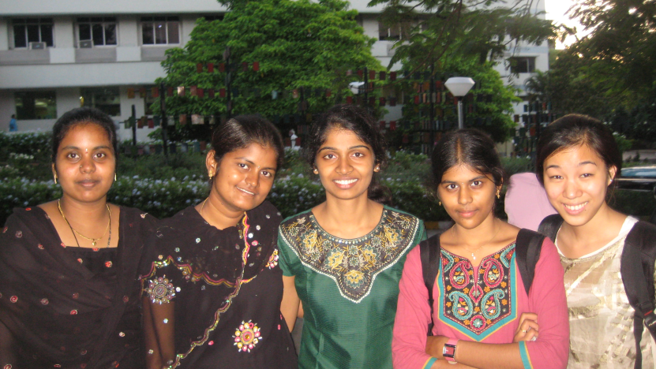
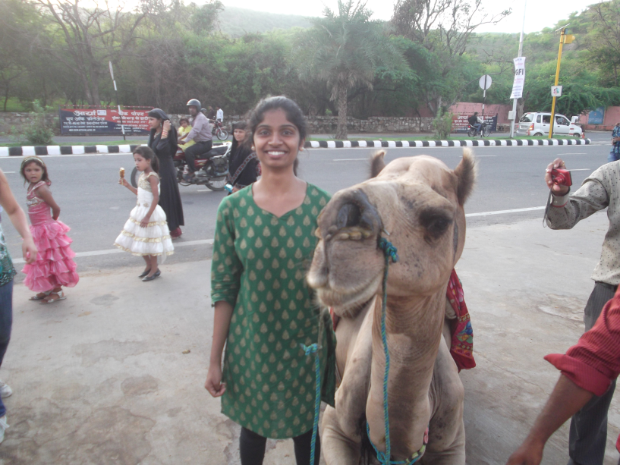
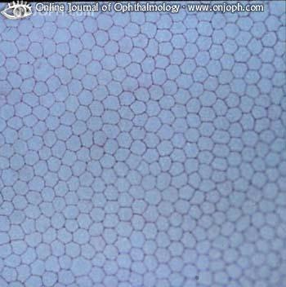
Athavi Jeevananthan
Senior in Biochemistry
Summer research internship: Khorana Program
Funded self by Hilldale & RISE fellowship
Worked in L V Prasad Eye Institute (LVPEI) in Hyderabad, India
Project: In vitro cultivation of human corneal endothelial cells (HCECs)

Slide 20
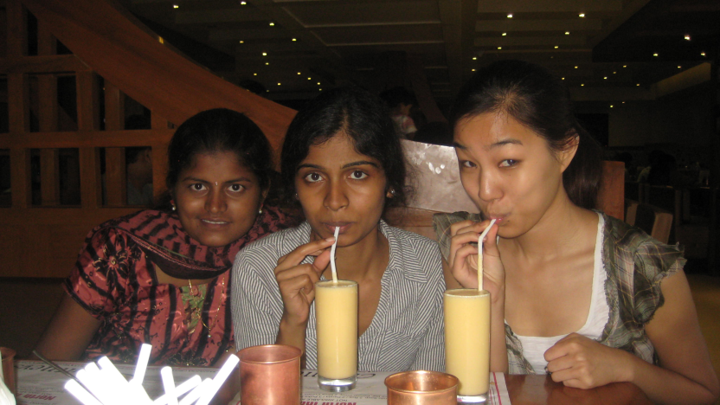
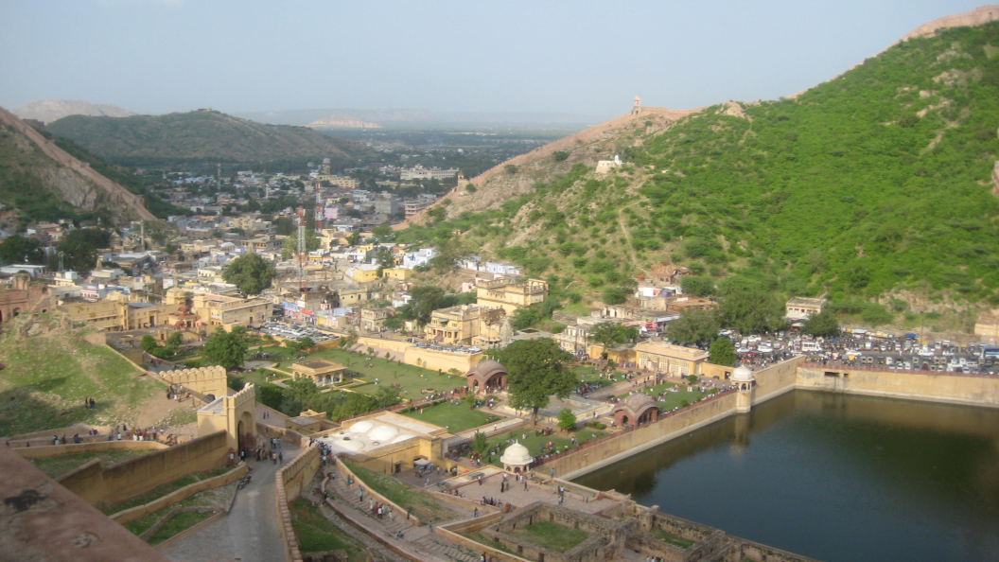
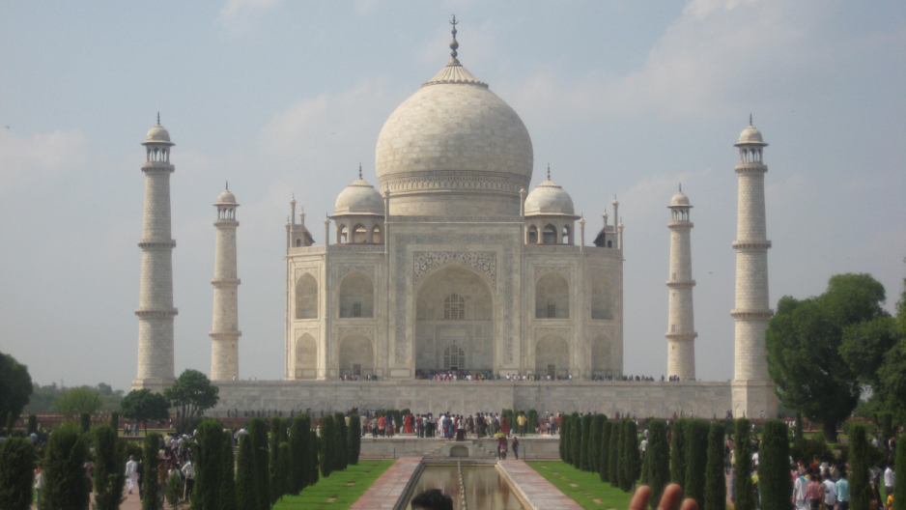
Athavi JEevananthan
Acquired valuable primary culture techniques
Research in a hospital setting
Shadowed surgeries
Traveled to Delhi, Agra, and Jaipur with fellow interns
Formed lasting connections with friends and faculty
Contact: ajeevanantha@wisc.edu

Slide 21
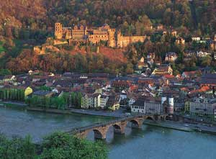
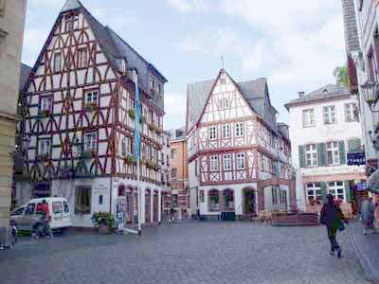
Summer Program to Experience Research - Germany
European Molecular Biology Laboratory (EMBL) in Heidelberg, Germany
Deadline: December 3rd
Program: Late May to August 23 (13 weeks)
http://ip.cals.wisc.edu/for-students/choose-a-program/international-internships/super-g-summer-program-in-european-research-germany/

Slide 22
Other CALS Internships
Biochemistry and Molecular Biology Research Internship at the University of Hong Kong
KongUmeå Plant Science Center and Umeå University, Sweden
Conservation Biology Research in Iceland
Horticulture and Entomology Internship, Costa Rica
Natural Product Development, Costa Rica

Slide 23
Ok, you’ve sparked my interest…now I have some questions:

Slide 24
What kind of programs are out there for me to choose from?
Summer
Winter
Semester
Year
Internship
Field Study

Slide 25
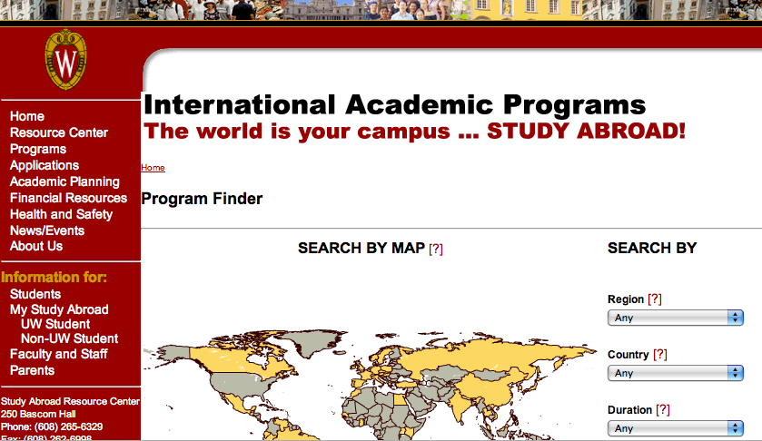
Where do I look for programs?
IAP website: (studyabroad.wisc.edu)

Slide 26
But isn’t that just for language-based programs?
Nope!!

Slide 27
Do I have to speak a foreign language?
Nope!!

Slide 28
Find science-related opportunities
http://ip.cals.wisc.edu/for-students/choose-a-program/

Slide 29
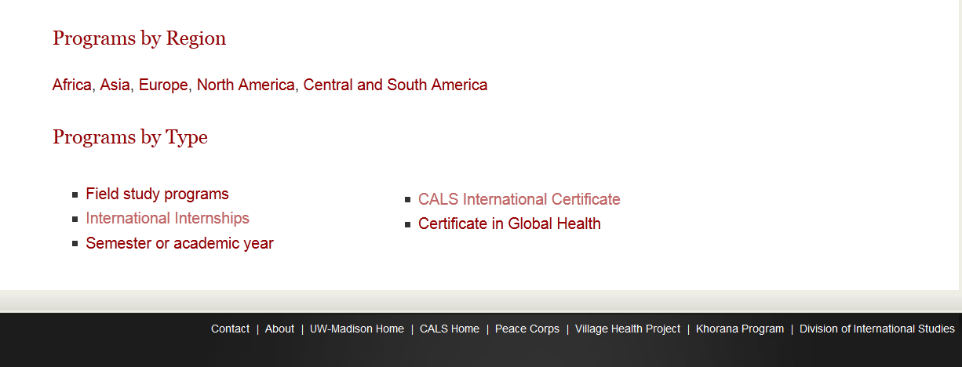
What was that about Certificates and internships abroad?

Slide 30
Okay, I’m interested. What should I do now?
Think about it.
How long do I want to be abroad?
How long can I afford to be abroad? ($, time, etc.)
Talk about it.
Meet with an IAP advisor for a program you are interested in (through IAP) or the CALS IP advisor for a CALS program

Slide 31
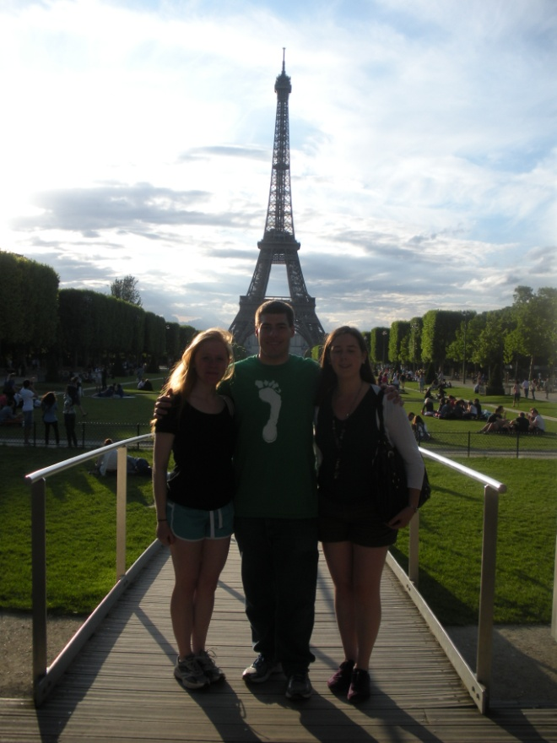
Make it Happen!
Application deadlines vary widely
Passports need processing time
Plane tickets just get more expensive
Above all have fun!

